Slide 1

Basic Details of the Team and Problem Statement
Ministry/Organization Name/Student Innovation:
Student Innovation
PS Code:
SIH1487 Problem Statement Title:
Waste Management Team Name:
Zeta Team Leader Name:
Linju Rajan Institute Code (AISHE):
C-37046 Institute Name:
Hindusthan Institute of Technology
Theme Name:
Smart Waste Management System

Slide 2
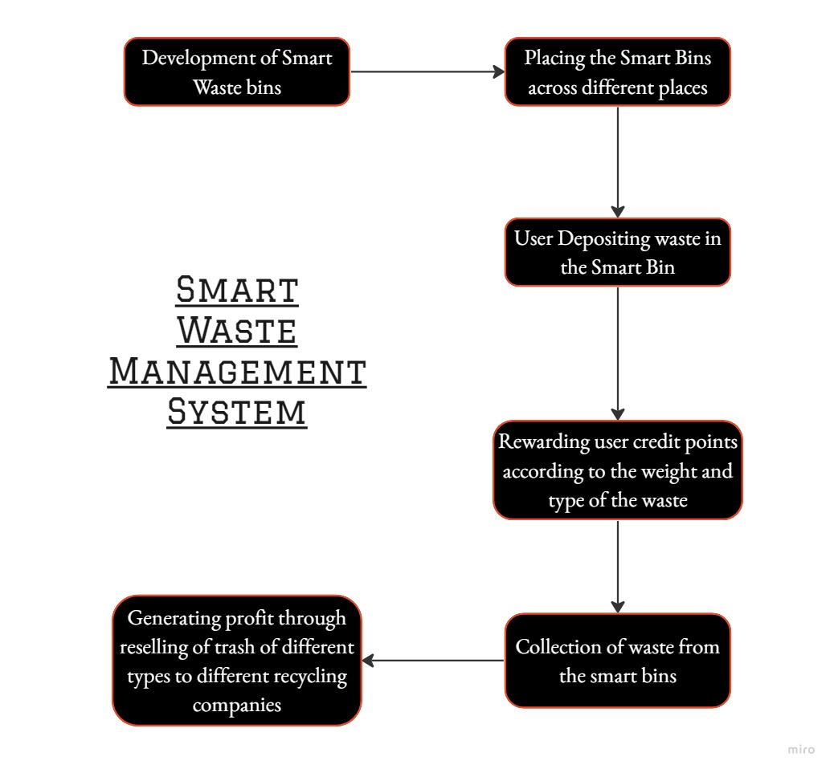
Idea/Approach Details
Solution/Prototype:
Development of smart bins.
Smart Bins uses its sensors to detect the capacity of the bins and notifies the collectors when it is full.
Collectors collects the trash from the bins and sends it for recycling purposes.
Smart Waste Management system also rewards people according to the type of the trash collected from them, by doing this we aim to attract more people to Smart Bins and keeping the cities and places clean.
Rewarding system is connected with IoT, user can check his credit points through the mobile app and redeem it for various purposes.
Technology stack:
Internet of Things (IoT)
Radio-frequency identification(RFID)
GPS Tracking
Machine Learning
Software
Cloud Computing

Slide 3
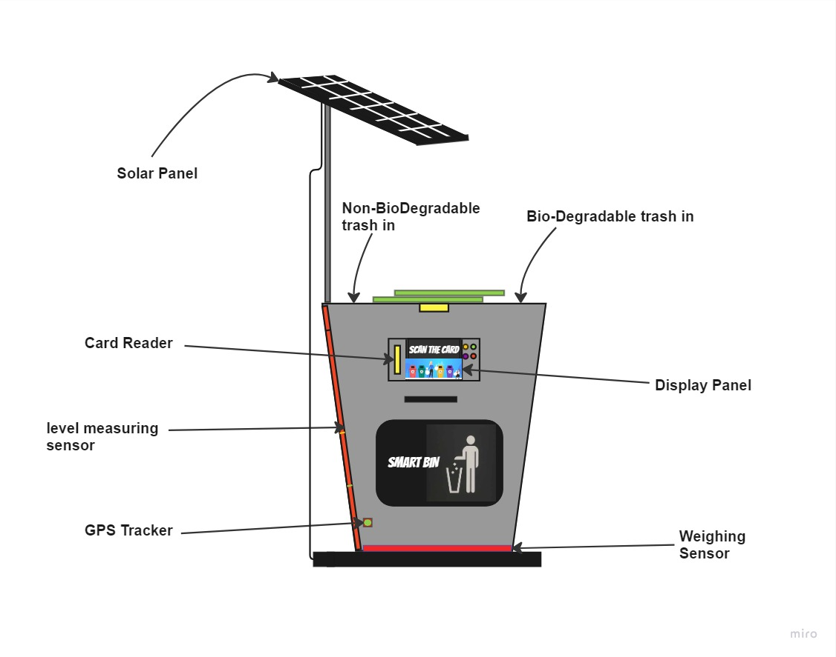
Idea/Approach Details
Use Cases:
Reducing pollution
Illegal dumping could be eliminated
Real-time monitoring of waste levels
Automatic notifications
Waste data analytics
Dependencies:
Public engagement
Availabilty of robust and widespread network
Reliable sensor
User interface and communication channel
Transport facilities
Rely on companies

Slide 4
Team Member Details
Team Leader Name: Linju Rajan
Branch: B.E. Stream: CSE Year III
Team Member 1 Name: Abijith K
Branch: B.E. Stream CSE Year III
Team Member 2 Name : Adil Abdul Nassar
Branch B.E.: Stream CSE Year III
Team Member 3 Name: Abijith C P
Branch B.E. Stream CSE Year III
Team Member 4 Name: Karthik Sujith
Branch B.E. Stream CSE Year III
Team Member 5 Name: Abhilash S
Branch B.E. Stream CSE: Year III
Team Mentor 1 Name: K.Murugan
Category Academic Expertise Knowledge Database Domain Experience 10 years
Team Mentor 2 Name: Saranya.S
Category Academic: Expertise Data Science,Image processing Domain Experience 5 years

Slide 5
Important Pointers
Please ensure below pointers are met while
Kindly keep the maximum slides limit to 4 pages
All the topics should be utilized for description of your idea
Try to avoid paragraphs and post your idea in points
Keep your explanation precisely and easy to understand
Idea should be unique and novel. If it has a business potential more weightage will be given.
Apart from this PPT abstract of your idea will be asked separately while submitting
You need to save the file in PDF and upload the same on portal. No PPT, Word Doc or any other format will be supported
You can delete this slide (Important Pointers) when you upload the details of your idea on SIH portal.

